Slide 1
EDA On Loan Applications Data
Arkuti Rajkumar , ID - 264, Jan 2022

Slide 2
Agenda
The Objectives of this presentation are to discuss the benefits of knowing the potential customers who can repay the loan before approving the loan and It also explains how the existing data can be used to draw some actionable insights from it,
Topics that will be covered include:
Exploring the Loan applications data
Data pre profiling
Data cleaning
Data post profiling
Exploratory data analysis
Presenting the actionable insights

Slide 3
Problem Statement
The Banking or Finance sectors facing problem of loan defaulters and if it keeps going the business is in stake to avoid the defaulters Bank needs to know the potential customers who can repay the loan amount before approving the loan
Finding Potential customers to provide the loans in all applicants is our main goal
The problem to identify the customers segments, those are eligible for loan amount so that they can specifically target these customers.

Slide 4
Loan Applications data information
Records | Features | Dataset Size
614 | 13 | 62.4 KB
There are total 614 records with 13 features
As explained each attribute in the table with the complete description
And we are trying to figure out the main feature which effects the Loan status
# | Feature Name | Feature Description
1 | Loan_ID | A 8-digit number uniquely assigned to each Applicant
2 | Gender | Applicant Gender (Male/Female)
3 | Married | Applicant relation status
4 | Dependents | No of dependents
5 | Education | Education of Applicant
6 | Self_Employed | Whether the applicant self employed or not
7 | ApplicantIncome | Income of the applicant
8 | CoapplicantIncome | Income of the co-applicant
9 | LoanAmount | Laon amount in thousands
10 | Loan_Amount_Term | Loan amount term in months
11 | Credit_History | credit history meets guidelines (0, 1)
12 | Property_Area | Urban / Semi Urban / Rural
13 | Loan_Status | Loan approved (Y/N)

Slide 5
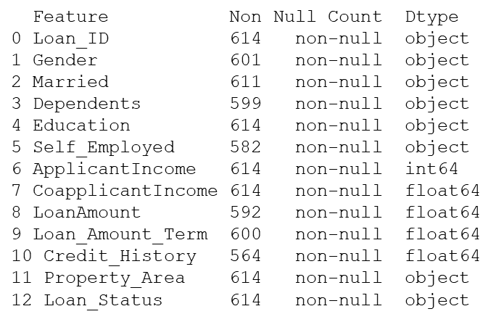
Pre Processed Data Info Observations
Data Info – Pre - Processed
Observations:
Find the missing values in 7 features out of 13
Imputed them with mean/median/mode depending on the data type of the missing values feature
Observed data types of each feature looks fine

Slide 6
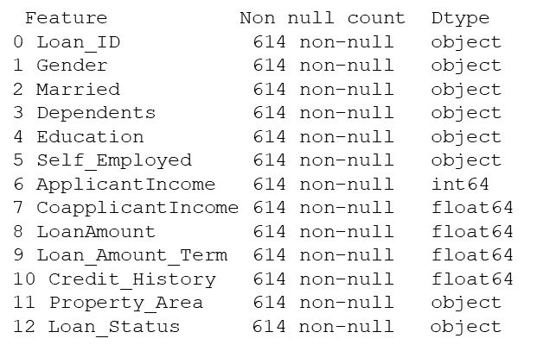
Post Processed data Information
Data Info – Post Processes
Imputed Nan values as below:
Gender feature Nan with mode
Married feature Nan with mode
Dependents feature Nan with mode
Self Employed feature Nan with mode
Loan amount feature Nan with mean
Loan amount term feature Nan with mode
Credit history feature Nan with mode

Slide 7
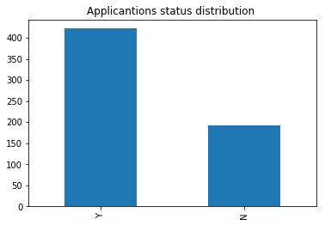
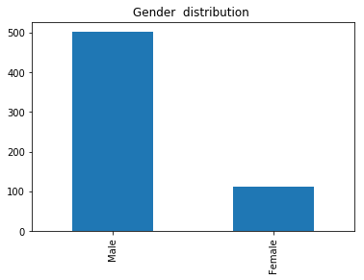
Loan Status Distribution & Gender Distribution
Exploratory Data Analysis – Univariate
Out of 614 Applications 422 applications are selected for loan and 192 were not selected
There are 502 male applicants and 112 Female applicants

Slide 8
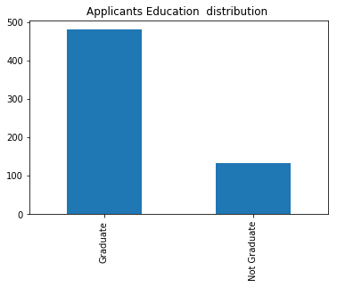
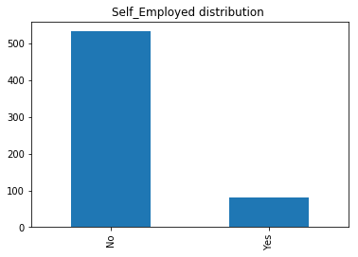
Applicants Employment and Education distribution
Exploratory Data Analysis – Univariate
Graduate Applicants are 480 and Not Graduate applicants are 134 There are 502
There are very less people (82 nos) who are self employed

Slide 9
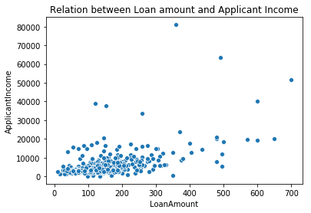
Loan Amount and Applicant Income relationship
Exploratory Data Analysis – Bivariate
- Most of the points are lies between 100k to 300k loan amount and 10k applicant income

Slide 10
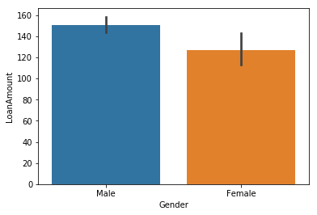
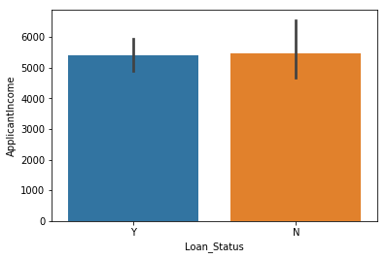
Gender with Loan Amount & Loan status with Applicant Income
Exploratory Data Analysis – Bivariate
The average Loan amount applied by Male is 150K and Female is 127K
Average applicant income is also same in both approved and not approved, lets sum applicant Income and see

Slide 11
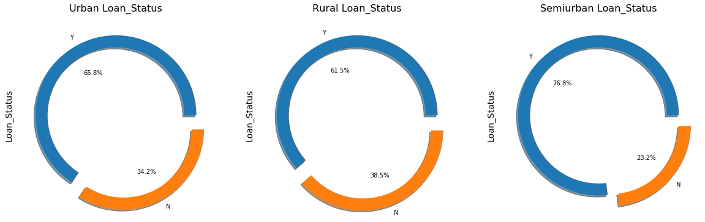
Ratio of approved applicants based on the property area
Exploratory Data Analysis – Multi variate
In Rural and Urban applicants loan approvals is similar and in Semi urban Laon approvals are way more than other Areas

Slide 12
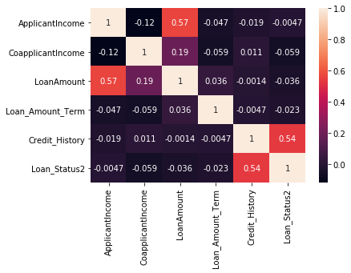
Co-relation strengths between Loan status and other numerical features
Exploratory Data Analysis
Loan status is highly co related with Credit history in positive direction with the strength of 0.54
Which means we can target the Credit history feature

Slide 13
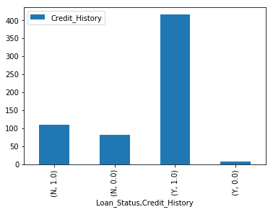
Credit history with Loan status
Exploratory Data Analysis
Credit history with 1 of 415 applications got approved loans
Credit history with 0 of 7 applications not approved loans
But why loans not approved for credit history with 1 and those are 110 applicants

Slide 14
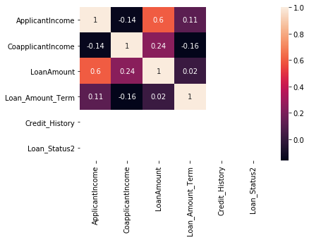
Filtered data – Credit history =1, Loan Status = No
Exploratory Data Analysis
Loan amount is highly positive with the strength of 0.6 whose applicants rejected even the credit history 1
We got Co applicant income has an effect in negative strength and applicant income in positive strength

Slide 15
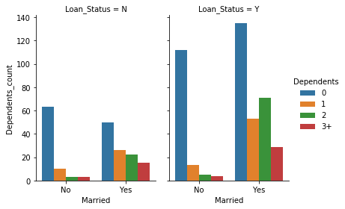
Married with More/less dependents on Loan status
Exploratory Data Analysis
0 dependents have a high probability of Loan approval and no much difference of Married or Un Married

Slide 16
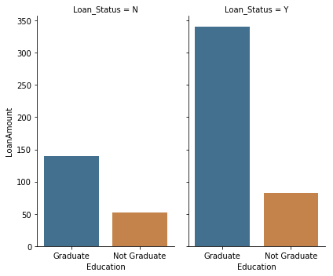
Education with applicant Income on Loan Status
Exploratory Data Analysis
Graduate applicants have high probability of approval of loan

Slide 17
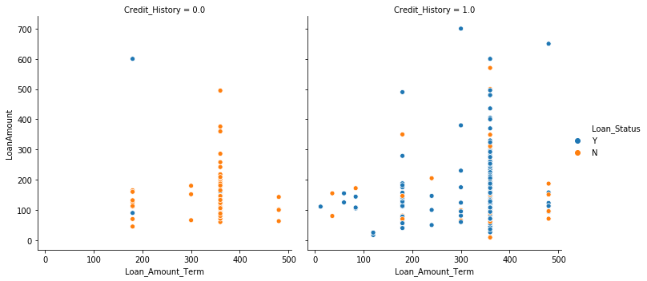
Loan amount and Loan amount term with credit history on loan status
Exploratory Data Analysis
There is no such co relation between Loan amount and Loan amount term with Loan status
But there is chance to get loan not approve with Low loan amount and high Loan amount term
It is clear that if the credit history is 1 applicants have high chance to get loan approved

Slide 18
Conclusion
In Finding of potential customers to get loan approved and target them to more accurate and high success rate in loan business
We drawn some actionable insights to present it to the management to take necessary actions for more productive
The Bank/Finance company facing the issue of loan defaulters and to avoid them these insights can play the significant role
- The actionable insights are in below section
Actionable Insights
The major factor is Credit history - If it meets the guidelines then the applicant is potential customer to sanction the loan
Another potential customer to repay are Employed
And the 0 dependents are suitable to potential customers to repay the loan
If any customers are in category of low loan amount and high loan amount term they are not suitable

